Slide 1
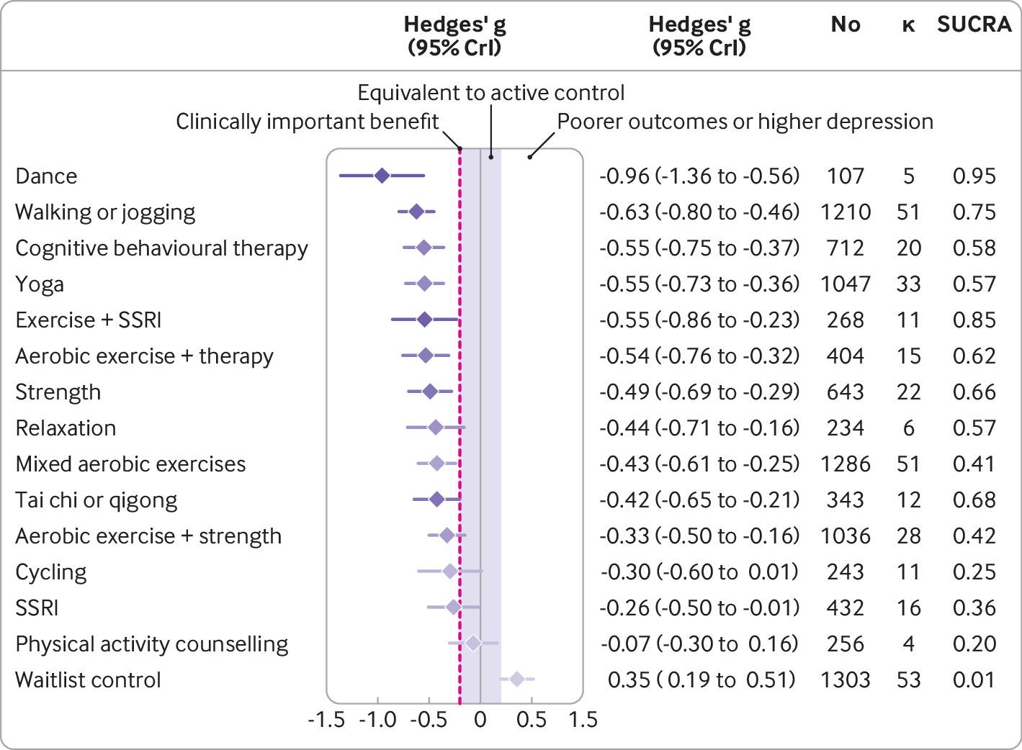

Predicted effects of different exercise modalities on major depression compared with active controls (eg, usual care), with 95% credible intervals.
Michael Noetel et al. BMJ 2024;384:bmj-2023-075847
©2024 by British Medical Journal Publishing Group
Notes:
Predicted effects of different exercise modalities on major depression compared with active controls (eg, usual care), with 95% credible intervals. The estimate of effects for the active control condition was a before and after change of Hedges’ g of −0.95 (95% credible interval −1.10 to −0.79), n=3554, κ =113. Colour represents SUCRA from most likely to be helpful (dark purple) to least likely to be helpful (light purple). SSRI=selective serotonin reuptake inhibitor; SUCRA=surface under the cumulative ranking curve

